Slide 1
Binary Search in C#
Presentation prepared by
Vihar Dasari ( VD ) - NB HealthTech

Slide 2
INDEX
What is Binary Search ?
How It Works ?
Code
Output
Topics

Slide 3
What is Binary Search ?
Binary Search is a searching algorithm which works on sorted array.
The search element is compared with the middle element of the array. If equality is not found then half part of the array in which the value isn’t there is eliminated
Then the other half of the array is searched.

Slide 4
What is Binary Search ?

Slide 5
Lets see, How It Works !...........(with an example)
Eg. search = 37
i = 0 1 2 3 4 5 6 7 8 9
6 | 11 | 14 | 17 | 21 | 25 | 29 | 37 | 42 | 59
low
mid
high
Since (arr [mid] < search)
(right half array is searched )
These elements are eliminated
6 | 11 | 14 | 17 | 21 | 25 | 29 | 37 | 42 | 59
low
mid
high
Since (arr [mid] == search)
(search element is found)
6 | 11 | 14 | 17 | 21 | 25 | 29 | 37 | 42 | 59
low
mid
high
6 | 11 | 14 | 17 | 21 | 25 | 29 | 37 | 42 | 59
i = 7

Slide 6
C# Code
using System;
namespace binarysearch
{
internal class Program
{
static void Main(string[] args)
{
int[] arr = { 2, 3, 4, 10, 40 };
int n = arr.Length;
int x ;
Console.WriteLine("Enter search element : ");
x = Convert.ToInt32(Console.ReadLine());
int result = binarysearch(arr, 0, n - 1, x);
if (result == -1)
Console.WriteLine("Element not present");
else
Console.WriteLine("Element found at index " + result);
}
static int binarysearch(int[] arr, int l, int r, int x)
{
if (r >= l)
{
int mid = l + (r - l) / 2;
if (arr[mid] == x)
return mid;
if (arr[mid] > x)
return binarysearch(arr, l, mid - 1, x);
return binarysearch(arr, mid + 1, r, x);
}
return -1;
}
}
}
Initializing
Logic

Slide 7
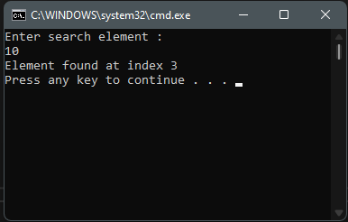
Output

Slide 8
FIN.

